Slide 1
Goal: Build a Predictive Thermal Model for Zn-MnO2 Cells
Calibrate and validate a model that predicts cell temperature when cells are subjected to various currents
Malesa Sammy 04/02/2026

Slide 2
Experimental Plan
Four sequential tests — two parameters measured directly from data
1
2
3
4
1
R0 Measurement (GITT)
Calibration Cycling
Validation Test
Convection coefficient Measurement
Method
Method
Method
Method
44 A pulse → OCV cool-down
22 A / 10 s pulses, 100% → 10% SOC
15 A & 30 A, 30 min pulses
Unseen current level on fresh cell
Output
Output
Output
Output
Fit T(t) = T∞ + ΔT·e^(−t/τ)
R0 = |ΔV| / I at each SOC
Validate model + ageing rate
Blind prediction vs. measurement
Completed ✓
Completed ✓
Next step ⟶
Future
Parameters: h_conv — measured from Test 1 | R0 — measured from Test 2 | Cycling/Ageing rate — verified in Test 3

Slide 3
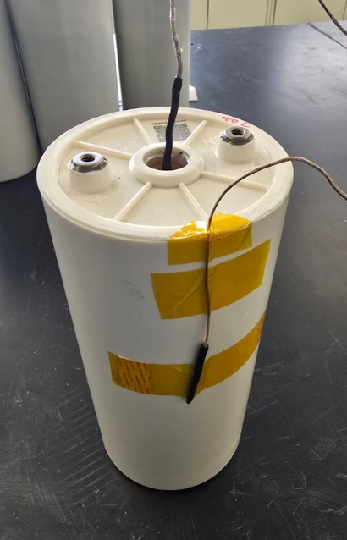
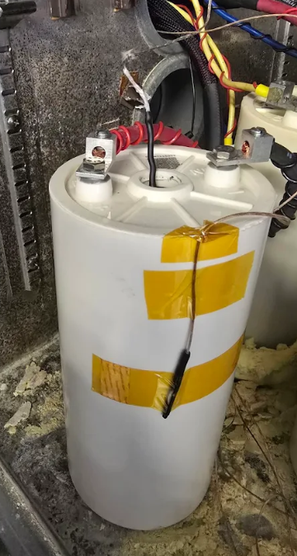
Experimental Set Up
One thermocouple inserted halfway down the center of the jellyroll- this measures the center temperature and the entire jellyroll is assumed to be at this temperature.
One thermocouple halfway along the height of the cell canister- this is used as the surface temperature for the model

Slide 4
Test 1- Convection coefficient (h)
44 A pulse → full OCV cool-down | Fitted: T(t) = T∞ + ΔT₀ · exp(−t/τ) | h = m·c_p / (τ·A)
1.46
m = 3 kg (jelly roll mass)
W/m²·K
c_p = 1400 J/kg·K
h_conv RT (23°C)
A = 0.0709 m² (outer surface)
Fit Quality (R²)
2.44
RT: 0.931 ← good
40°C: 0.839 (ΔT only 1°C)
W/m²·K
h_conv 40°C
Method
Q_gen = 0 during OCV rest
τ = 676 min
Fit ln(T − T∞) vs time
Slope = −1/τ
RT time constant
h = m·c_p / (τ · A)

Slide 5
Test 2- Internal Resistance R0
22 A × 10 s pulses at 10% SOC steps | R0 = |ΔV| / I | Mid-SOC average used as model value
2.03 mΩ
mid-SOC avg
R0 RT (23°C)
1.97 mΩ
mid-SOC avg
R0 40°C
−3%
lower R at higher T ✓
Ratio 40°C / RT
Model R0 value: mid-SOC average (20–80% SOC) where response is flat and measurement is most reliable
RT: 2.028 mΩ (0.002028 Ω) | 40°C: 1.967 mΩ (0.001967 Ω) | Data quality flags: Good ≤30 s lag · Acceptable ≤120 s · Caution >120 s

Slide 6
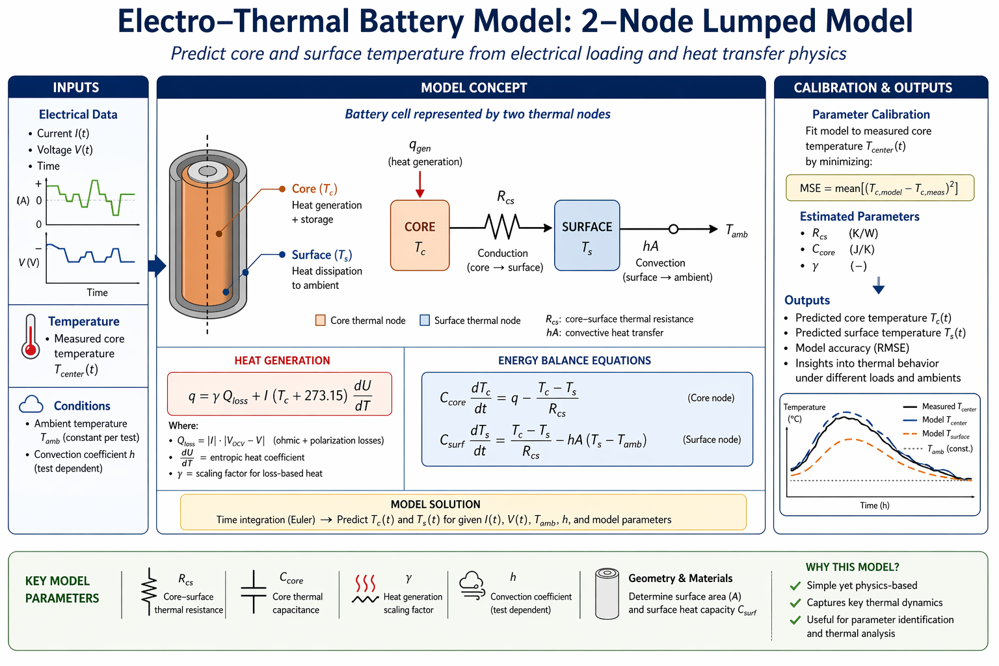
Thermal Model Concept

Slide 7
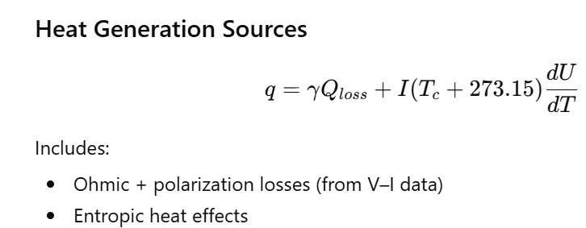
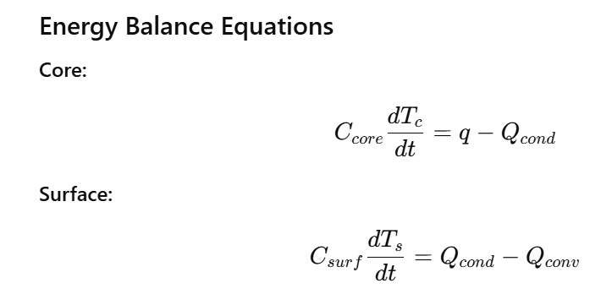
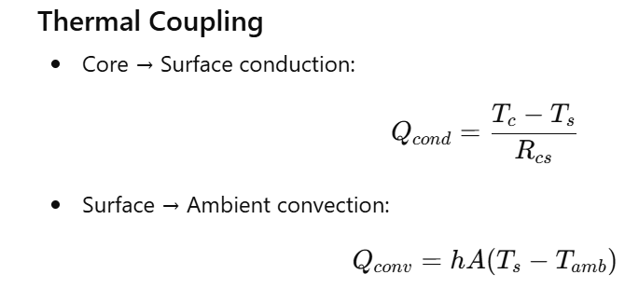
Thermal Model Concept
The cell is simplified into a 2-node thermal system:
Core (electrochemical region) → heat generation + storage
Surface (cell can) → heat dissipation to ambient
Heat flows in a 1D thermal path:
Core → Surface → Ambient

Slide 8
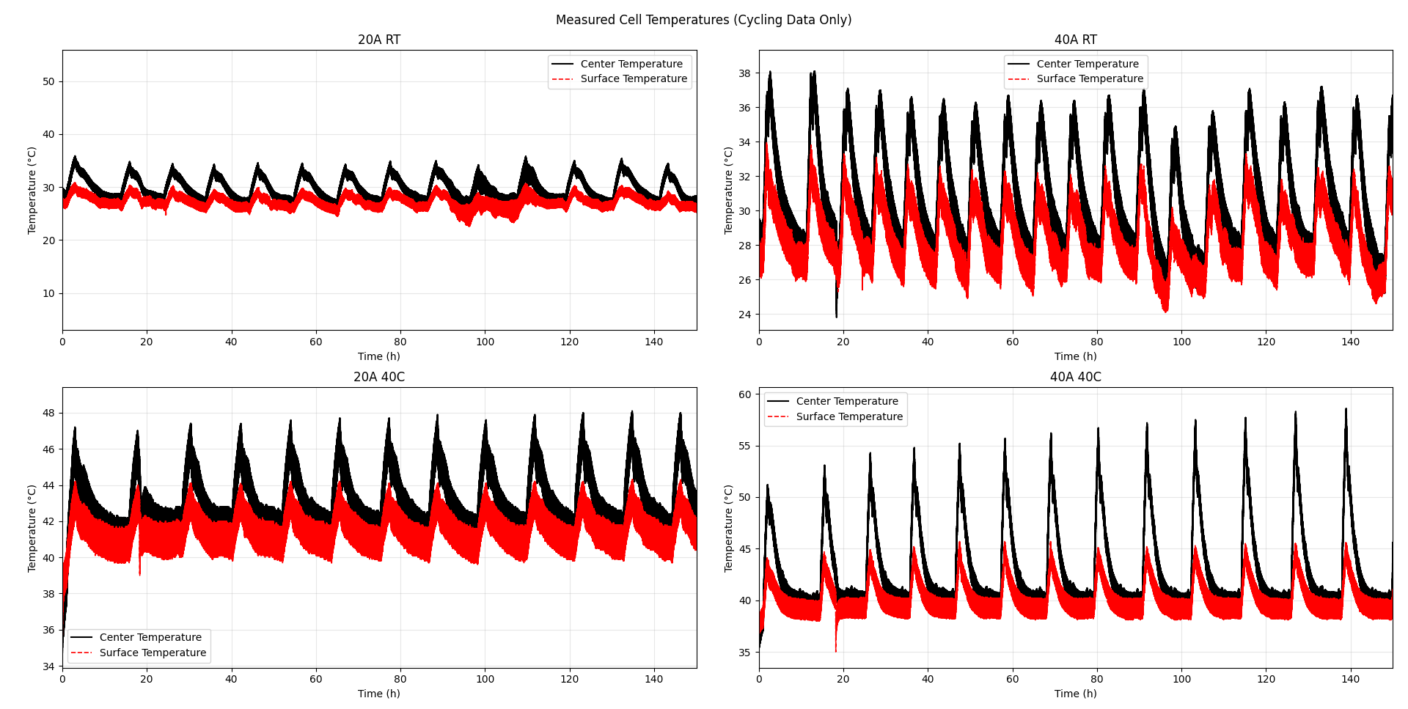
Test 3- Calibration Cycling

Slide 9
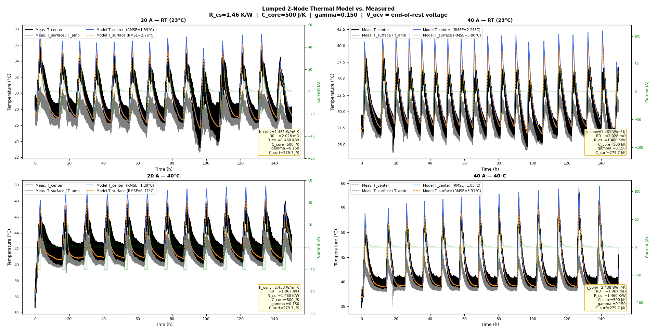
Test 3- Calibration Cycling- Model
Here, the model uses the surface temperature as the ambient condition
Next step: constant ambient temperature

Slide 10
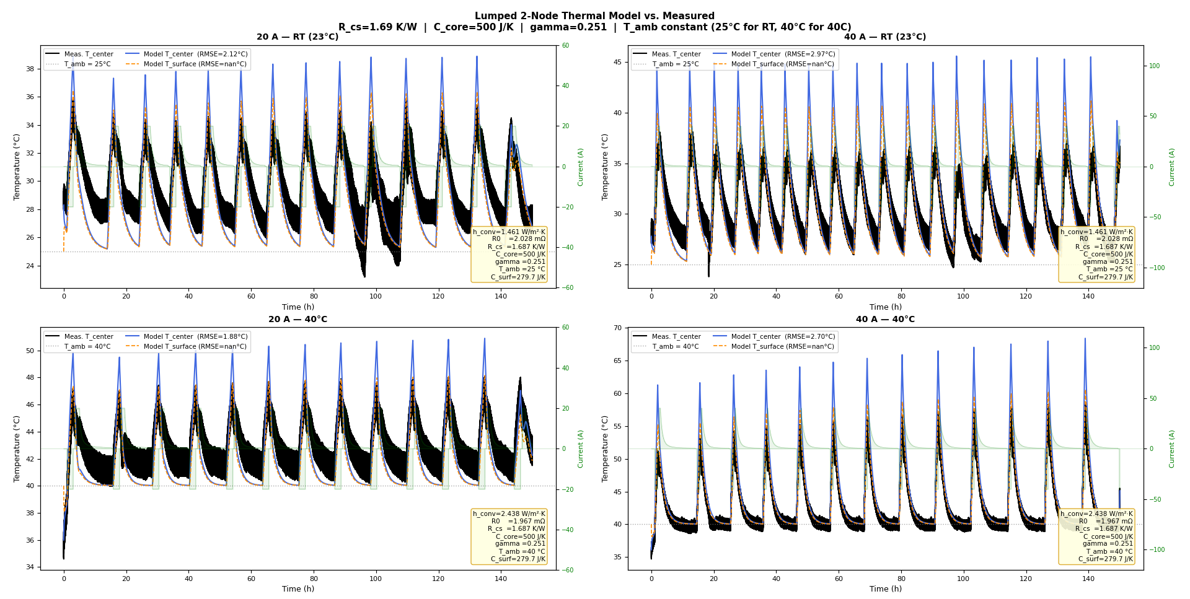
Test 3- Calibration Cycling- Constant Ambient T

Slide 11
Test 3- Calibration Cycling- Constant Ambient T
Next Steps:
Determine why the model breaks for the surface temperatures (it gives nan C)
Continue calibrating the model so that the RMSE is </= 1°C
Try the model on other cells

